Slide 1
Wednesday, August 22, 2012
Homework:
p. 81-82 #42-50 even
TISK Problems
Simplify: $\frac{14}{\sqrt{7}}$
Simplify: $\frac{8x+24}{16}$
Factor completely: $−24x+48x^{2}+3$
No Mental Math Today

Slide 2
Homework Check
20) Hypothesis: You don’t know where you are going. Conclusion: You will probably end up somewhere else.
22) Hypothesis: You are an NBA basketball player. Conclusion: You are at least 5’2” tall.
24) Hypothesis: You are an adult. Conclusion: You are at least 21 years old.
26) If you are a champion then you are afraid of losing.
28) If a triangle is equiangular then it is equilateral.
30) If two lines are perpendicular then they form right angles.
32) Right angles are acute angles.
34) A cardinal is a dog.
Continued…

Slide 3
Homework Check
36) If it is a square then it is a quadrilateral. Converse: If it is a quadrilateral then it is a square. False; a trapezoid is a quadrilateral but is not a square.
Inverse: If it is not a square then it is not a quadrilateral. False; a trapezoid is not a square but it is a quadrilateral.
Contrapositive: If it is not a quadrilateral then it is not a square. True.
38) Converse: If two adjacent angles are congruent, then their common side bisects the larger angle. True.
Inverse: If a ray does not bisect an angle, then the two angles formed are not congruent. True.
Contrapositive: If two adjacent angles are not congruent, then their common side does not bisect the larger angle. True.
40) If two angles are vertical then they are congruent.
Converse: If two angles are congruent then they are vertical. False;
these two angles are congruent but not vertical. Inverse: If two angles are not vertical then they are not congruent.
False; these two angles are not vertical but are congruent.
Contrapositive: If two angles are not congruent, then they are not vertical. True.

Slide 4
§2.2 Continues
6 Postulates About Lines & Planes
Through any two points there is exactly one line.
Through any three points not on the same line, there is exactly one plane.
A line contains at least two points.
A plane contains at least three points not on the same line.
If two points lie in a plane, then the entire line containing those two points lies in that plane.
If two planes intersect, then their intersection is a line.

Slide 5
Line Postulates Activity
You will get into groups of 4 or 5 and get 2 white boards, 4-5 markers, and 2 erasers.
For each of the 6 postulates you wrote down, write it in if-then form, then write its inverse, converse, and contrapositive.
Then, decide as a group whether they are valid.
You will have about 15 minutes to do so.
Questions?

Slide 6
Stop!
Time to share!
I will call on a randomly selected student to tell us what your group came up with for one of the 6 postulates.
When called on, read each of your group’s statements then tell us whether the group felt it was true or false and why.

Slide 7
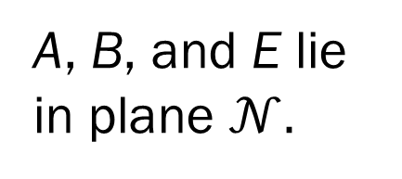


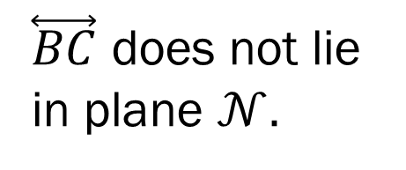
More Examples
Determine whether the given statement is true or false. State the postulate you would use to defend your answer.
E
A, B, and E lie in plane $𝒩.$
$$𝒩$$
A
$\overset{⃡}{BC}$ does not lie in plane $𝒩.$
B
4) False; through any two points there is exactly one line, therefore there cannot be a different line that contains A and B as well as D.
D
C
A, B, C and E are coplanar.
2) False; if two points lie in a plane, then the entire line containing those two points lies in that plane.
1) False, $\overset{⃡}{EB}$ is not contained in plane $𝒩$; only point B on that line is, so all three points are not contained in the plane.
A, B, and D are collinear.
3) True; through any three points not on the same line, there is exactly one plane.

